Slide 1

QUIZ PUZZLE-GAMIFIED LEARNING
SOORAJ K P
MES24MCA-2056
Department of Computer Applications
MES College of Engineering, Kuttippuram
20-08-2025

Slide 2
PRODUCT OWNER Ms. C M SULAIKHA ASSISTANT PROFESSOR DEPARTMENT OF COMPUTER APPLICATIONS MES COLLEGE OF ENGINEERING, KUTTIPPURAM

Slide 3
TABLE OF CONTENTS
Introduction
Objective
Existing System
Proposed System
Motivation
Functionalities
Module Description
Developing Environment
Sprint Backlog
Product Backlog
User Story
Project Plans
Data Flow Diagrams
ER Diagram

Slide 4
QUIZ PUZZLE-GAMIFIED LEARNING
Enhances student engagement through interactive quizzes and gamification
Each correct quiz answer uncovers a puzzle piece, motivating learners to complete the image.
Combines quizzes with a puzzle-based image reveal system to make studying interactive and fun.Encourages active participation, curiosity, and self-paced learning
Provides personalized dashboards for students to track their progress.

Slide 5
QUIZ PUZZLE-GAMIFIED LEARNING
Enables administrators to easily create, edit, and manage quizzes from a centralized panel.
Aims to deliver a user-friendly, rewarding educational experience for both learners and educators.

Slide 6
OBJECTIVES
Increase student engagement by integrating gamification into the learning process.
Encourage active participation and curiosity through interactive quiz-based activities.
Provide continuous motivation through a reward-based puzzle image reveal system.
Offer personalized dashboards for students to monitor progress and achievements.

Slide 7
EXISTING SYSTEM
Traditional online quiz platforms focus solely on question-and-answer formats without gamification.
Limited engagement strategies—no interactive or rewarding elements to maintain learner interest.
Mostly static learning experience, leading to reduced motivation and attention span.
Lack of visual incentives such as puzzles or progress-based rewards.

Slide 8
PROPOSED SYSTEM
Introduces a web-based gamified learning platform to increase student engagement and motivation.
Reveals a hidden image with each correct answer until complete.
Encourages active participation and curiosity through interactive quiz-solving.
Offers administrator tools for creating, managing, and monitoring quizzes efficiently.

Slide 9
MOTIVATIONS
Create a fun and rewarding learning experience that transforms routine study into an enjoyable activity.
Enhance the overall quality of digital education by blending entertainment with academic content.
Equip educators with easy-to-use tools for quiz creation, management, and monitoring.
Boost student confidence by providing instant feedback and visible progress after each quiz.

Slide 10
FUNCTIONALITIES
User Registration and login Secure sign-up and login system for students and administrators to access the platform.
Quiz creation and management (Admin) Administrators can create, edit, and delete quiz questions, set difficulty levels, and organize quizzes.
Puzzle integration Each correct answer unlocks a piece of a hidden puzzle image, adding excitement and motivation.

Slide 11
Quiz Participation (Student) Students can attempt quizzes, receive instant feedback, and track puzzle progress in real time.
Image Upload & Puzzle Configuration (Admin) Admins can upload puzzle images and configure them into pieces for different quiz levels.
ProgressTracking – Personalized student dashboards display quiz scores, puzzle completion, and learning milestones.

Slide 12
MODULE DESCRIPTION
1.Admin Module
Admin Registration/Login – Provides secure access for administrators to manage the platform.
Quiz Management – Create, edit, and delete quiz questions with flexible options.
Puzzle Image Management – Upload puzzle images and configure how pieces are revealed.
Student Management – View, manage, and monitor student accounts and activity.
Progress – Track student quiz performance

Slide 13
2. Student Module
User Registration/Login – Allows students to create accounts and log in securely.
Quiz Participation – Students attempt quizzes where each correct answer unlocks a puzzle piece.
Puzzle Completion – Completing all questions reveals the full image.
Personal Dashboard– View progress, achievements.

Slide 14
DEVELOPING ENVIRONMENT
Operating System: Windows 11
Front End: HTML5, CSS3, JavaScript
Back End: Python
Database: SQLite
IDE: Visual Studio Code
Version Control: Git & GitHub
Framework: Flask

Slide 15
SPRINT BACKLOG
Backlog tem | Status And Completion Date | Original Estimation in Hours | Day 1 hrs | Day 2 hrs | Day 3 hrs | Day 4 hrs | Day 5 hrs | Day 6 hrs | Day 7 hrs | Day 8 hrs | Day 9 hrs | Day 10 hrs
SPRINT1
UI Design (Login & Dashboard) | 28/08/2025 | 8 | 2 | 2 | 2 | 2 | 0 | 0 | 0 | 0 | 0 | 0
Quiz System | 02/09/2025 | 9 | 2 | 2 | 2 | 3 | 0 | 0 | 0 | 0 | 0 | 0
Puzzle Image Integration | 07/09/2025 | 8 | 2 | 2 | 1 | 1 | 1 | 1 | 0 | 0 | 0 | 0
SPRINT 2
Student Progress Dashboard | 11/09/2025 | 7 | 1 | 1 | 2 | 1 | 1 | 1 | 0 | 0 | 0 | 0
Admin panel | 16/09/2025 | 9 | 2 | 2 | 2 | 1 | 1 | 1 | 0 | 0 | 0 | 0

Slide 16
SPRINT BACKLOG
Backlog tem | Status And Completion Date | Original Estimation in Hours | Day 1 hrs | Day 2 hrs | Day 3 hrs | Day 4 hrs | Day 5 hrs | Day 6 hrs | Day 7 hrs | Day 8 hrs | Day 9 hrs | Day 10 hrs
SPRINT3
Testing & Debugging | 27/09/2025 | 10 | 2 | 2 | 2 | 2 | 1 | 1 | 0 | 0 | 0 | 0
Deployment & Documentation | 05/10/2025 | 6 | 2 | 2 | 2 | 0 | 0 | 0 | 0 | 0 | 0 | 0
TOTAL |  | 57 | 11 | 13 | 13 | 10 | 4 | 4

Slide 17
PRODUCT BACKLOG
ID | NAME | PRIORITY <high/medium/low> | ESTIMATE (Hours) | STATUS <Planned/In progress/Completed>
1 | UI Design (Login & Dashboard) | High | 8 | PLANNED
2 | Quiz Module | High | 9 | PLANNED
3 | Puzzle Image Integration | High | 8 | PLANNED
4 | Student Progress Dashboard | MEDIUM | 7 | PLANNED
5 | Admin Panel | High | 9 | PLANNED

Slide 18
PRODUCT BACKLOG
ID | NAME | PRIORITY <high/medium/low> | ESTIMATE (Hours) | STATUS <Planned/In progress/Completed>
6 | Testing & Debugging | High | 10 | PLANNED
7 | Deployment & Documentation | MEDIUM | 6 | PLANNED

Slide 19
USER STORY
User Story ID | As a type of User | I want to <Perform some task> | So that i can <Achieve Some Goal>
1 | ADMIN | Register | Allow authorized personnel to manage the platform
2 | ADMIN | Login | Securely access the admin dashboard with username and password
3 | ADMIN | Create and Manage Quizzes | Add, edit, and delete quiz questions for students
4 | ADMIN | Monitor Student Progress | Track performance, and puzzle completion
5 | USER | Register | Create an account to access quizzes and puzzles
6 | USER | Login | Securely access my personalized dashboard
7 | USER | Attempt Quizzes | Answer questions to reveal puzzle pieces and learn interactively

Slide 20
USER STORY
User Story ID | As a type of User | I want to <Perform some task> | So that i can <Achieve Some Goal>
8 | USER | View My Dashboard | Track my quiz performance and progress

Slide 21
PROJECT PLAN
User StoryID | Task Name | Start Date | End Date | Days | Status
1 | Sprint 1 | 25/08/2025 | 28/08/2025 | 14 | PLANNED
2 |  | 29/08/2025 | 02/09/2025 |  | PLANNED
3 |  | 03/09/2025 | 07/09/2025 |  | PLANNED
4 | Sprint 2 | 08/09/2025 | 11/09/2025 | 14 | PLANNED
5 |  | 12/09/2025 | 16/09/2025 |  | PLANNED
6 |  | 17/09/2025 | 21/09/2025 |  | PLANNED

Slide 22
PROJECT PLAN
User StoryID | Task Name | Start Date | End Date | Days | Status
7 | SPRINT 3 | 22/09/2025 | 27/09/2025 | 14 | PLANNED
8 |  | 28/09/2025 | 05/10/2025 |  | PLANNED

Slide 23
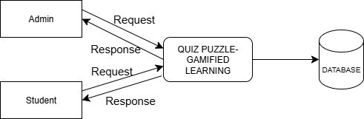
DATA FLOW DIAGRAM
LEVEL 0

Slide 24
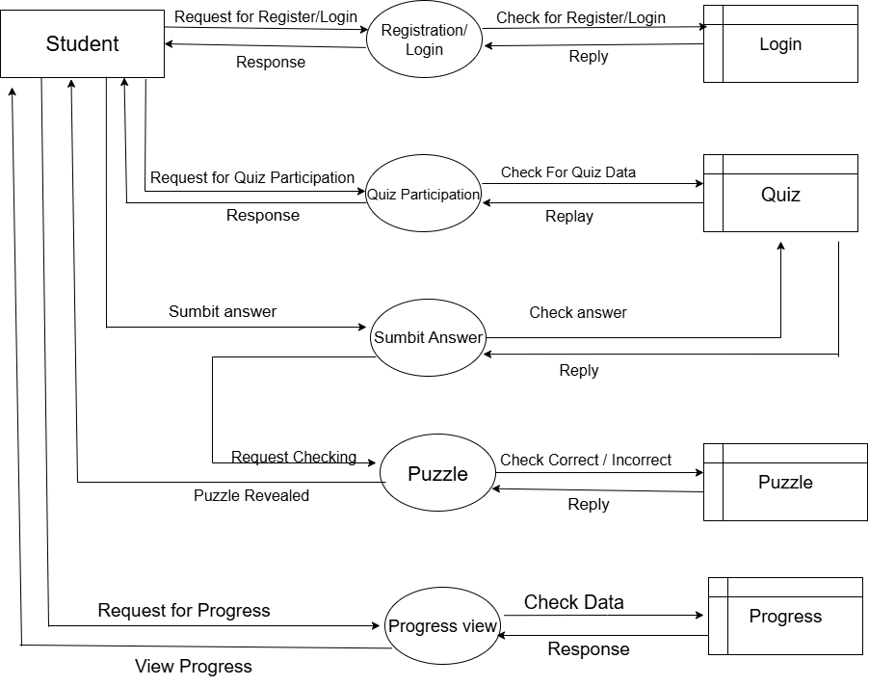
DATA FLOW DIAGRAM
Level 1

Slide 25
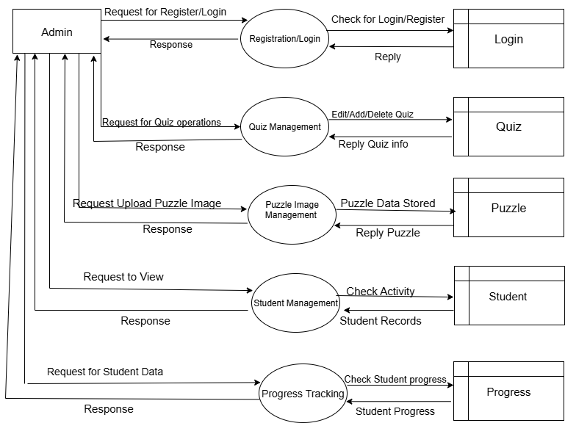
DATA FLOW DIAGRAM
Level 2

Slide 26
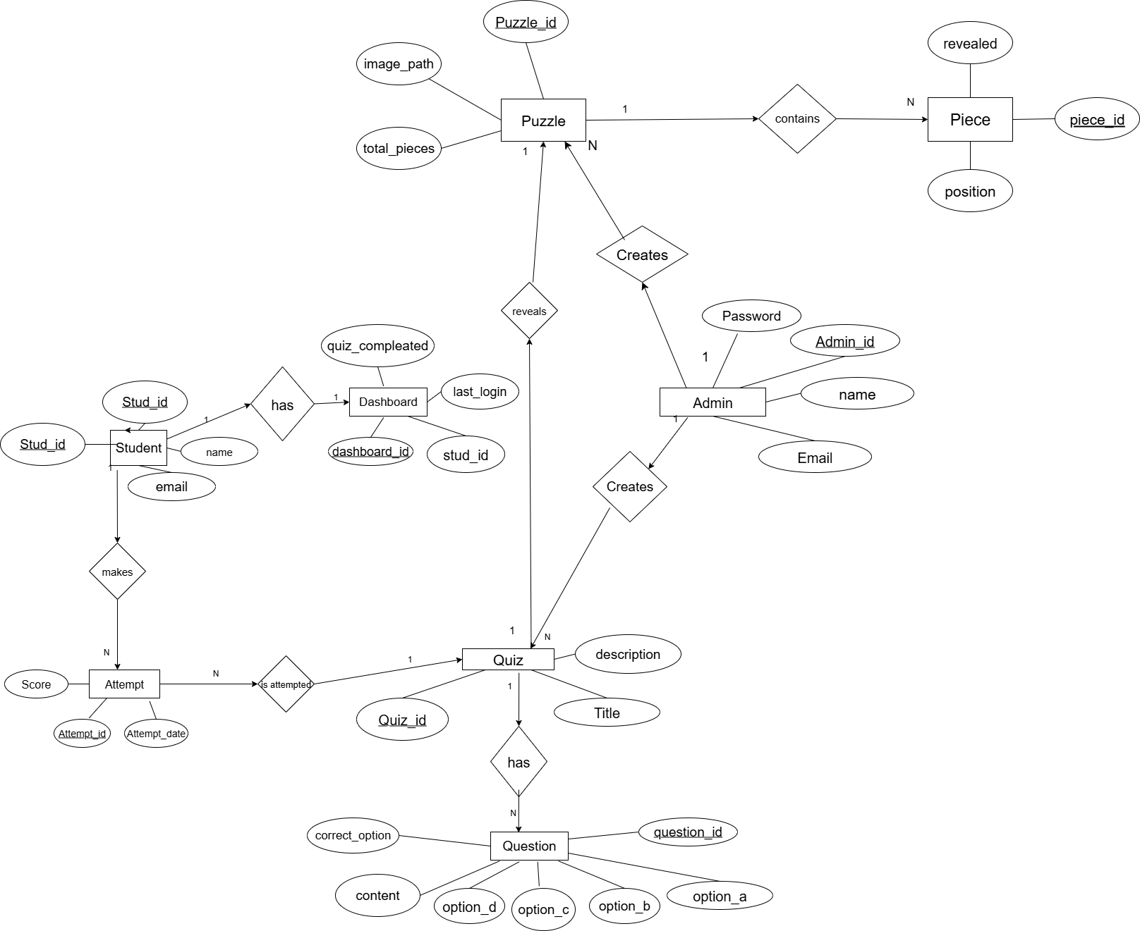
ER DIAGRAM

Slide 27
THANK YOU

